Slide 1


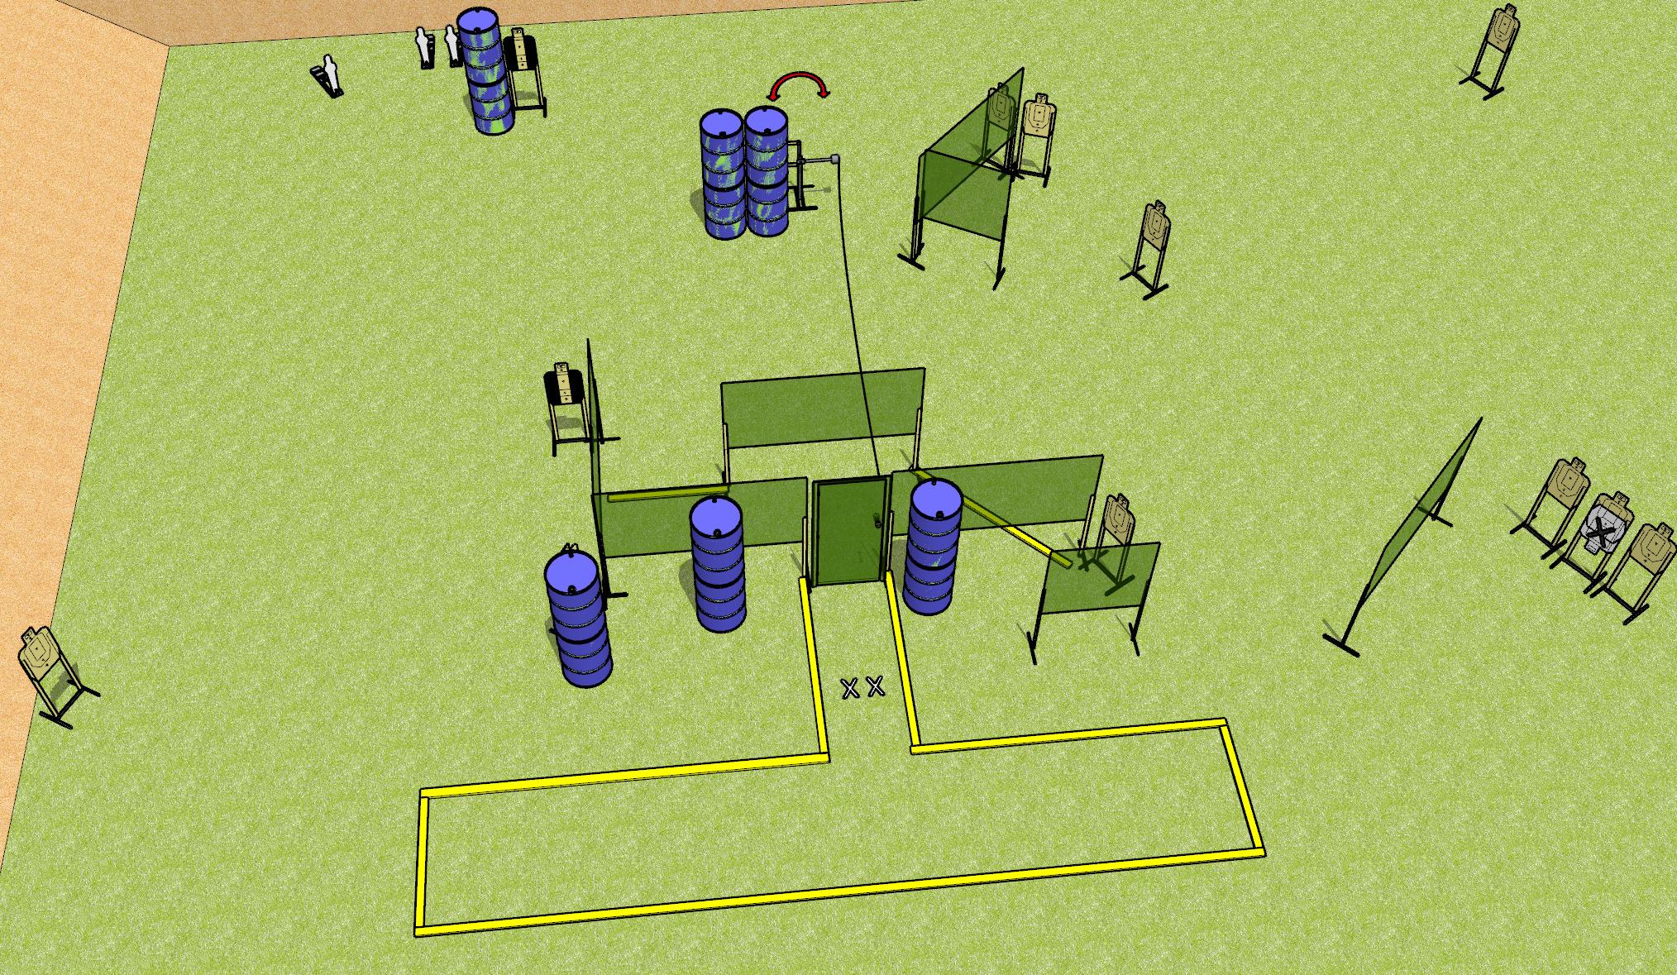
 | Dothan Gun Club – USPSA Match Mind the Wire Course Designer : Drew Coleman
START POSITION : Standing with both feet on X’s toes pointed towards door, wrists below belt
GUN READY CONDITION : Pistol loaded and holstered. PCC loaded, held with both hands, shouldered, safety on, pointed at door |  | SCORING: Comstock, 27 rounds TARGETS: 12 paper, 3 Steel SCORED HITS: Best 2 on paper, steel until down START-STOP: Audible, last shot RULES: Setup notes – use a hard cover for the swinger (deal with it Dan!)
STAGE PROCEDURE: Engage targets as they become available from within the fault lines.

Slide 2
Mind the Wire
Written Stage Briefing
Mind the Wire is a 27 round, 135 point, Comstock field course. There are twelve USPSA targets and three mini poppers. The best two hits on paper will score, and steel must fall to score. The start signal is audible.
The swinger is activated by the door (stomp box if present). Please check the activator prior to walkthrough and set it up the same way for every shooter.
Handgun start position is both feet on X’s, toes pointed at door, wrists below belt. Handgun is loaded and holstered.
PCC start position is both feet on X’s, toes and muzzle pointed at door. Loaded carbine is held with both hands, shouldered, safety on.
On start signal, engage targets as they become available from within the shooting area.

